Slide 1
Unsupervised Learning
Dr. Mehmet Yasin Ulukuş

Slide 2
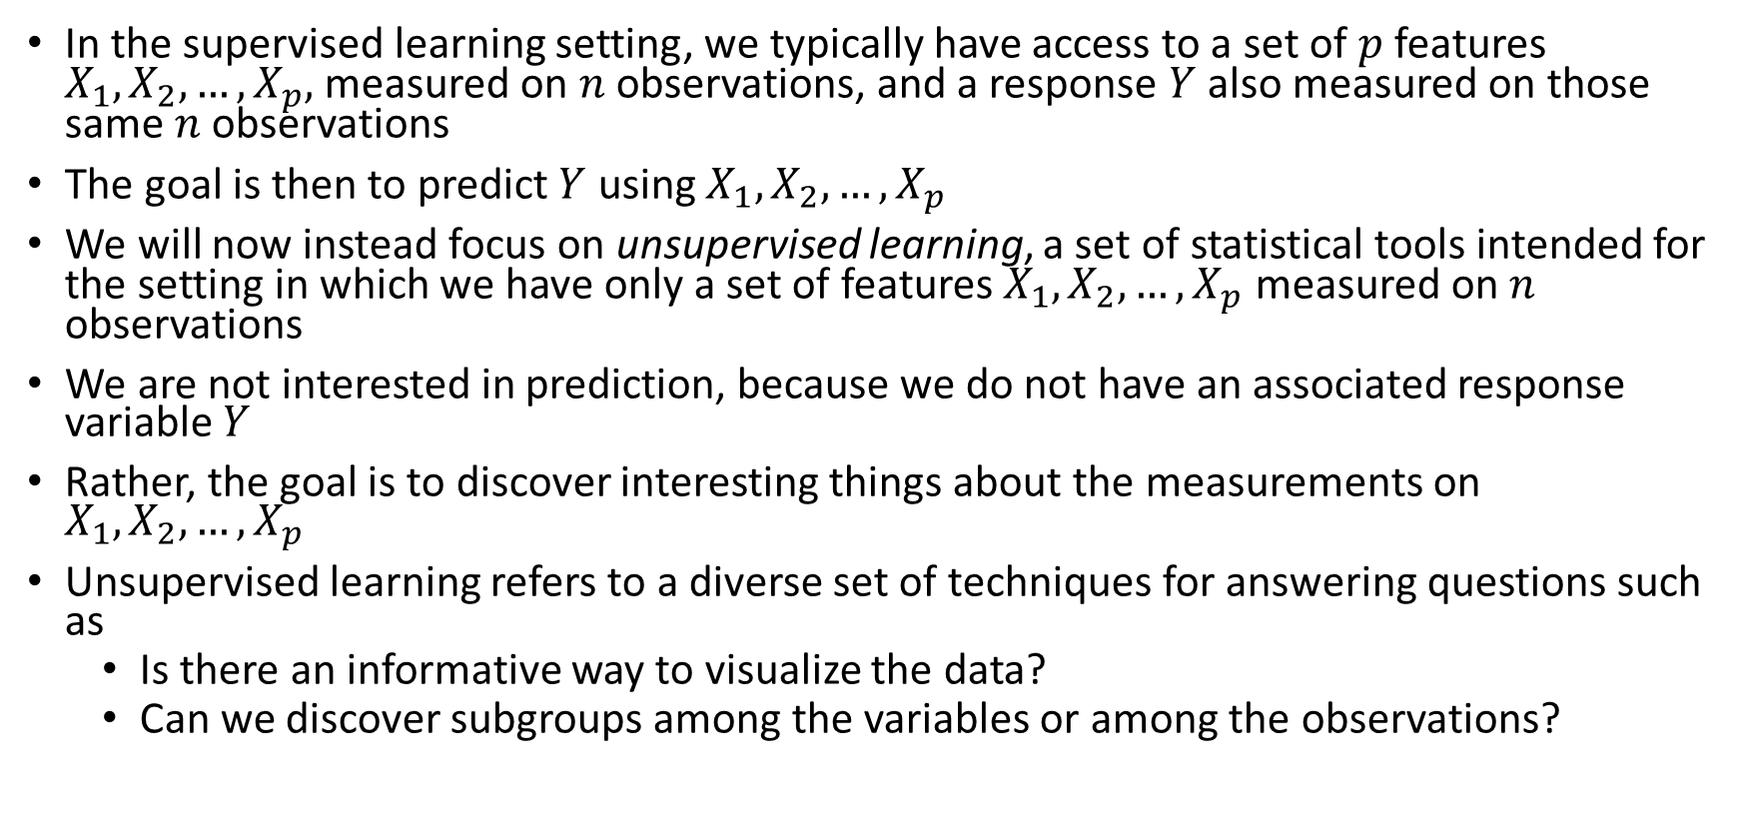
Unsupervised Learning
In the supervised learning setting, we typically have access to a set of $p$ features $X_{1},X_{2},…,X_{p},$ measured on $n$ observations, and a response $Y$ also measured on those same $n$ observations
The goal is then to predict $Y$ using $X_{1},X_{2},…,X_{p}$
We will now instead focus on unsupervised learning, a set of statistical tools intended for the setting in which we have only a set of features $X_{1},X_{2},…,X_{p}$ measured on $n$ observations
We are not interested in prediction, because we do not have an associated response variable $Y$
Rather, the goal is to discover interesting things about the measurements on $X_{1},X_{2},…,X_{p}$
Unsupervised learning refers to a diverse set of techniques for answering questions such as
Is there an informative way to visualize the data?
Can we discover subgroups among the variables or among the observations?

Slide 3
Unsupervised Learning - Challenges
Unsupervised learning is often much more challenging
It is more subjective, and there is no simple goal for the analysis, such as prediction of a response
Unsupervised learning is often performed as part of an exploratory data analysis
It can be hard to assess the results obtained from unsupervised learning methods, since there is no universally accepted mechanism for performing cross-validation or validating results on an independent data set

Slide 4
Unsupervised Learning – Some Application Examples
An online shopping site might try to identify groups of shoppers with similar browsing and purchase histories, as well as items that are of particular interest to the shoppers within each group
Then an individual shopper can be preferentially shown the items in which he or she is particularly likely to be interested, based on the purchase histories of similar shoppers
A search engine might choose what search results to display to a particular individual based on the click histories of other individuals with similar search patterns
Twitter users might be grouped together according to their reactions to certain events.

Slide 5
Clustering
Clustering refers to a very broad set of techniques for finding subgroups, or clusters, in a data set
When we cluster the observations of a data set, we seek to partition them into distinct groups
The observations within each group should be quite similar to each other, while observations in different groups should be quite different from each other
Of course, we must define what it means for two or more observations to be similar or different
Indeed, this is often a domain-specific consideration that must be made based on knowledge of the data being studied

Slide 6
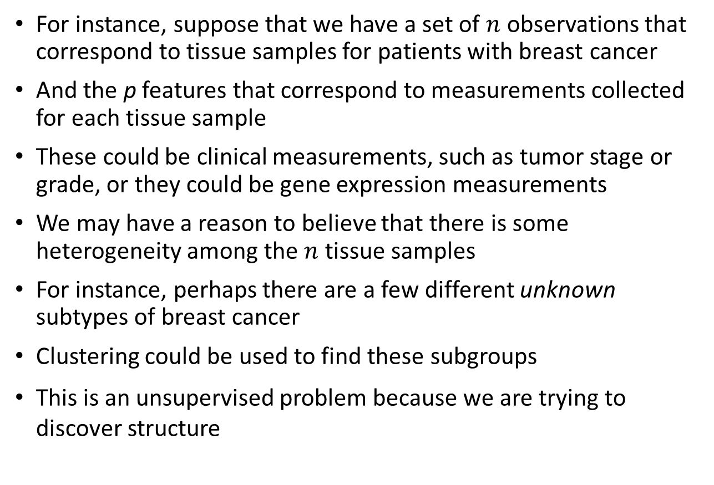
Clustering - Examples
For instance, suppose that we have a set of $n$ observations that correspond to tissue samples for patients with breast cancer
And the p features that correspond to measurements collected for each tissue sample
These could be clinical measurements, such as tumor stage or grade, or they could be gene expression measurements
We may have a reason to believe that there is some heterogeneity among the $n$ tissue samples
For instance, perhaps there are a few different unknown subtypes of breast cancer
Clustering could be used to find these subgroups
This is an unsupervised problem because we are trying to discover structure

Slide 7
Clustering - Examples
Another application of clustering arises in marketing
We may have access to a large number of measurements (e.g. median household income, occupation, distance from nearest urban area, and so forth) for a large number of people
Our goal is to perform market segmentation by identifying subgroups of people who might be more receptive to a particular form of advertising, or more likely to purchase a particular product
The task of performing market segmentation amounts to clustering the people in the data set

Slide 8
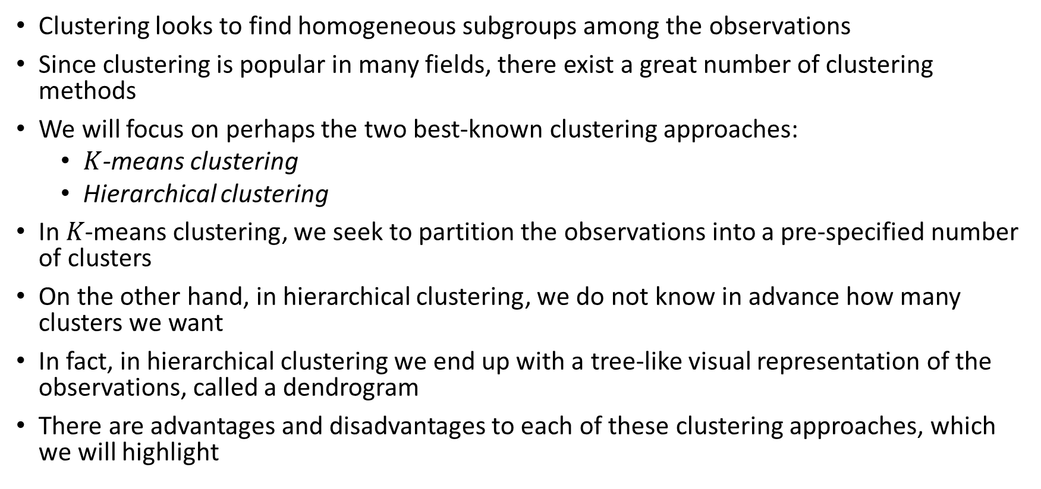
Clustering Techniques
Clustering looks to find homogeneous subgroups among the observations
Since clustering is popular in many fields, there exist a great number of clustering methods
We will focus on perhaps the two best-known clustering approaches:
$K$-means clustering
Hierarchical clustering
In 𝐾-means clustering, we seek to partition the observations into a pre-specified number of clusters
On the other hand, in hierarchical clustering, we do not know in advance how many clusters we want
In fact, in hierarchical clustering we end up with a tree-like visual representation of the observations, called a dendrogram
There are advantages and disadvantages to each of these clustering approaches, which we will highlight

Slide 9
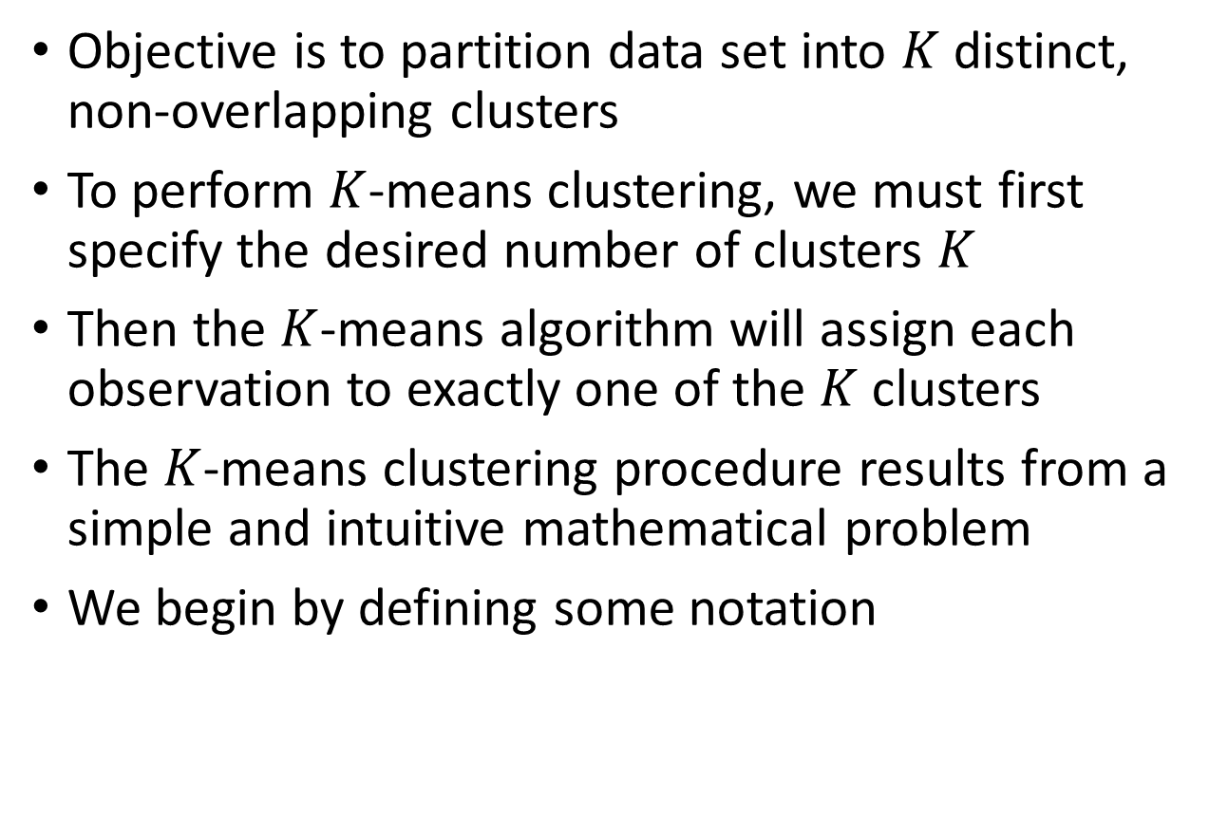
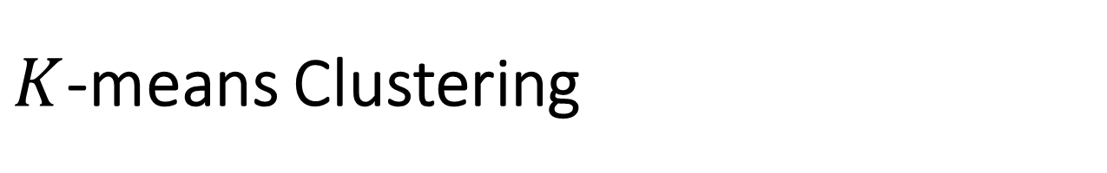
$K$-means Clustering
Objective is to partition data set into $K$ distinct, non-overlapping clusters
To perform $K$-means clustering, we must first specify the desired number of clusters $K$
Then the $K$-means algorithm will assign each observation to exactly one of the $K$ clusters
The $K$-means clustering procedure results from a simple and intuitive mathematical problem
We begin by defining some notation

Slide 10
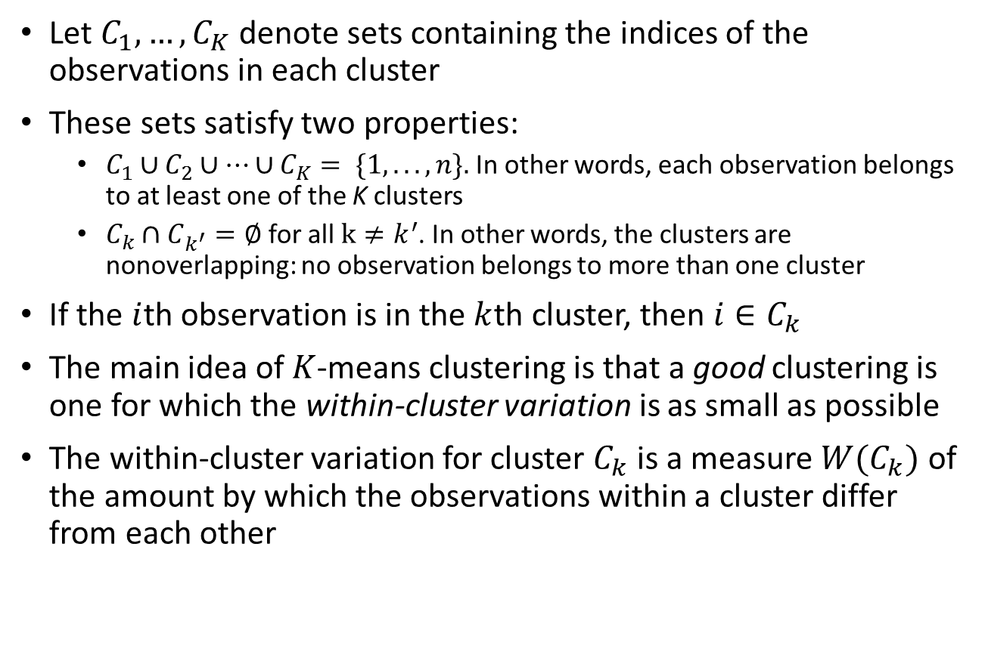
$K$-means Clustering
Let $C_{1},…,C_{K}$denote sets containing the indices of the observations in each cluster
These sets satisfy two properties:
$C_{1}∪C_{2}∪…∪C_{K}= \{1, . . ., n\}.$In other words, each observation belongs to at least one of the K clusters
$C_{k}∩C_{k^{′}}=∅$for all $k≠k^{′}$. In other words, the clusters are nonoverlapping: no observation belongs to more than one cluster
If the $i$th observation is in the $k$th cluster, then $i∈C_{k}$
The main idea of $K$-means clustering is that a good clustering is one for which the within-cluster variation is as small as possible
The within-cluster variation for cluster $C_{k}$ is a measure $W(C_{k})$ of the amount by which the observations within a cluster differ from each other

Slide 11
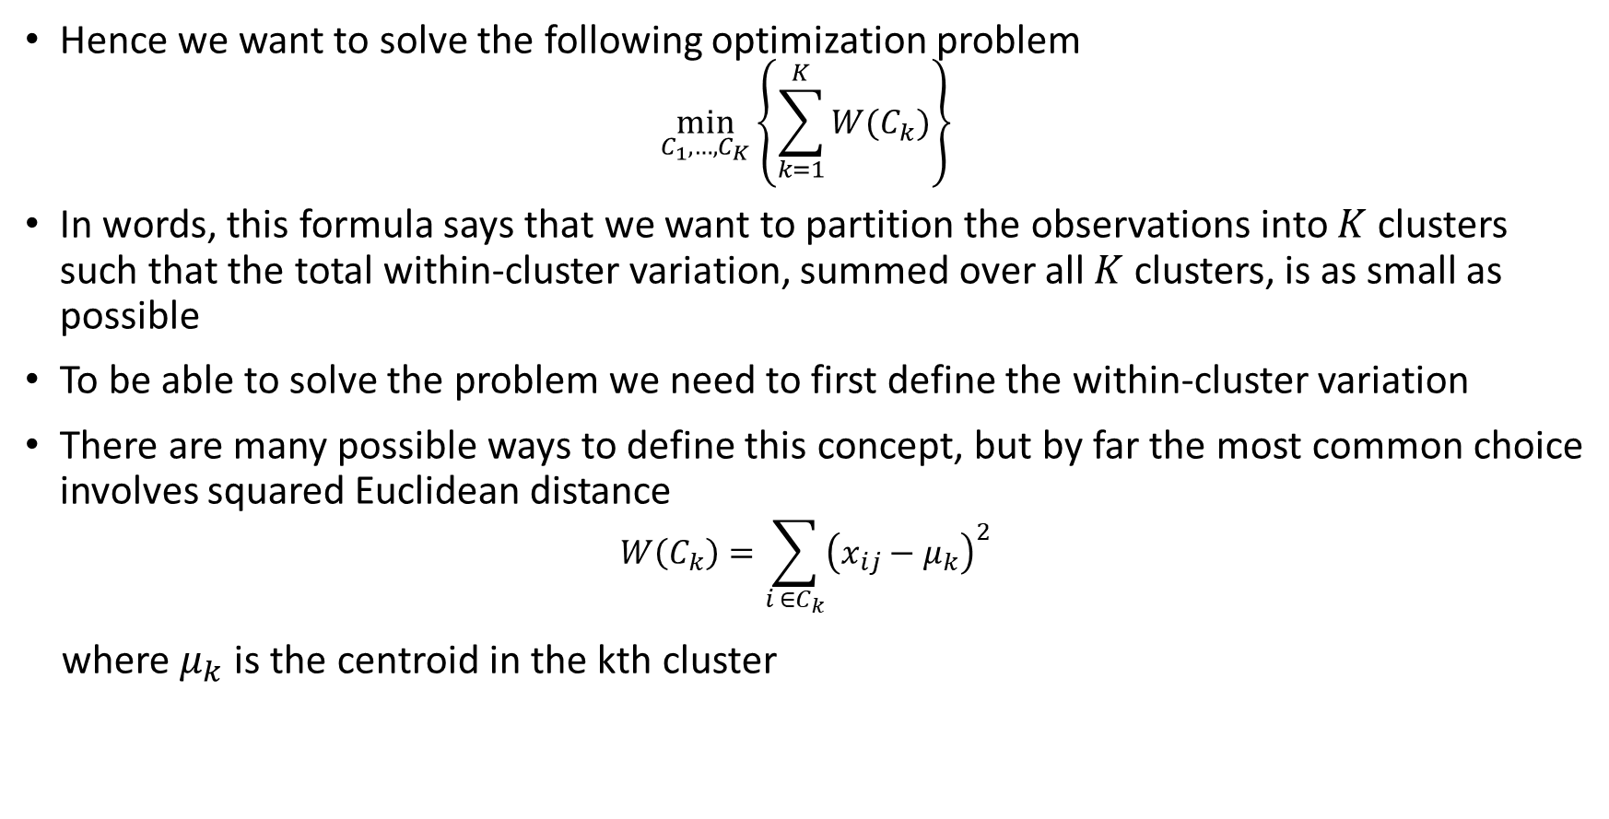
$K$-means Clustering
Hence we want to solve the following optimization problem
$$\min_{C_{1},…,C_{K}}\left\{\sum_{k=1}^{K}{W(C_{k})}\right\}$$
In words, this formula says that we want to partition the observations into $K$ clusters such that the total within-cluster variation, summed over all $K$ clusters, is as small as possible
To be able to solve the problem we need to first define the within-cluster variation
There are many possible ways to define this concept, but by far the most common choice involves squared Euclidean distance
$$W\left(C_{k}\right)=\sum_{i ∈C_{k}}{{\left(x_{ij}−μ_{k}\right)}^{2}}$$
where $μ_{k}$is the centroid in the kth cluster

Slide 12
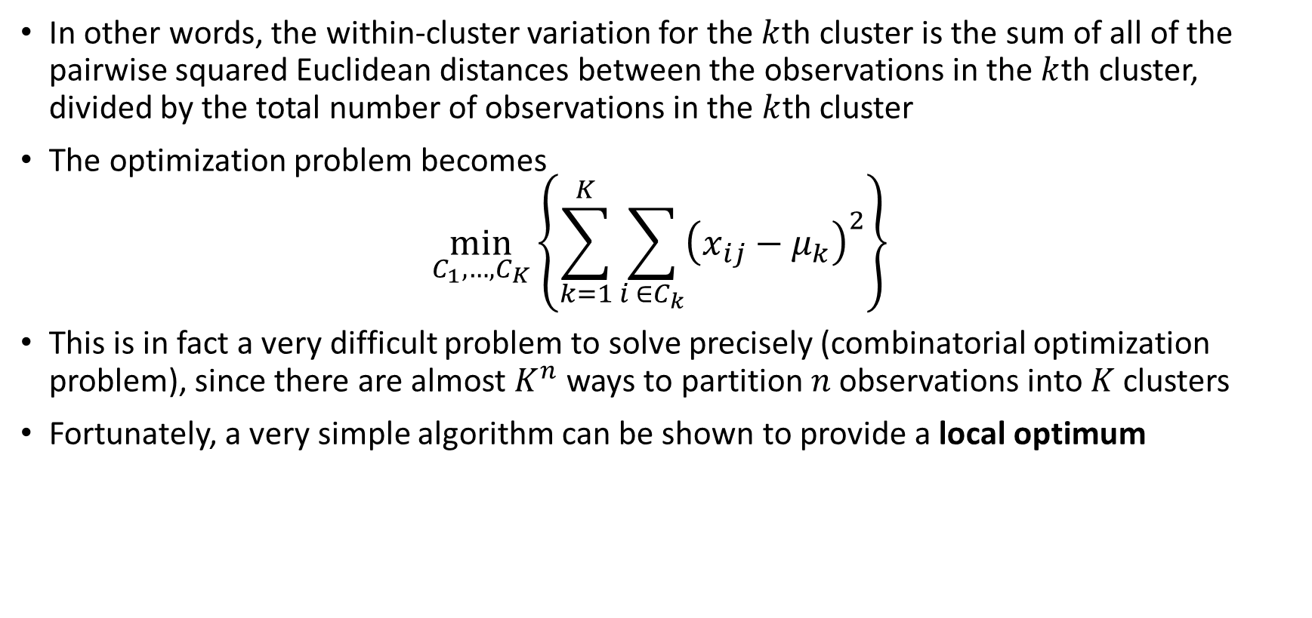
$K$-means Clustering
In other words, the within-cluster variation for the $k$th cluster is the sum of all of the pairwise squared Euclidean distances between the observations in the $k$th cluster, divided by the total number of observations in the $k$th cluster
The optimization problem becomes
$$\min_{C_{1},…,C_{K}}\left\{\sum_{k=1}^{K}{\sum_{i ∈C_{k}}{{\left(x_{ij}−μ_{k}\right)}^{2}}}\right\}$$
This is in fact a very difficult problem to solve precisely (combinatorial optimization problem), since there are almost $K^{n}$ ways to partition $n$ observations into $K$ clusters
Fortunately, a very simple algorithm can be shown to provide a local optimum

Slide 13
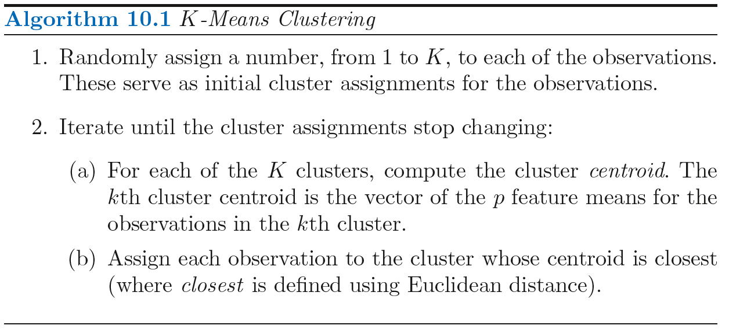
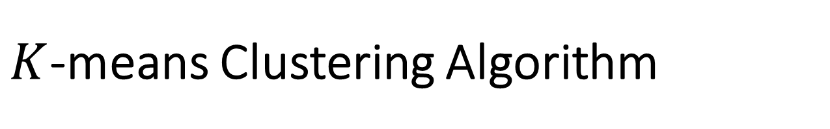
$K$-means Clustering Algorithm

Slide 14
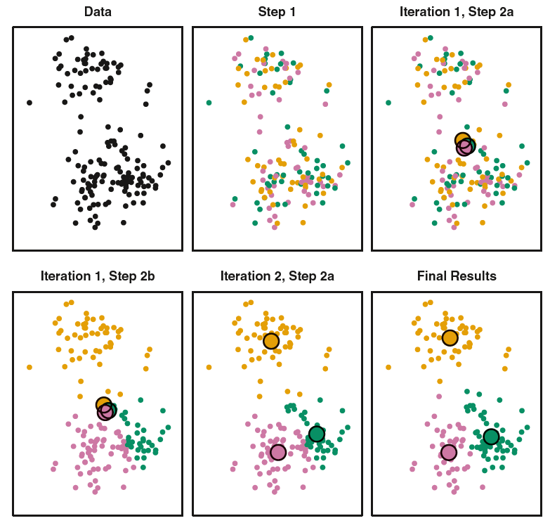
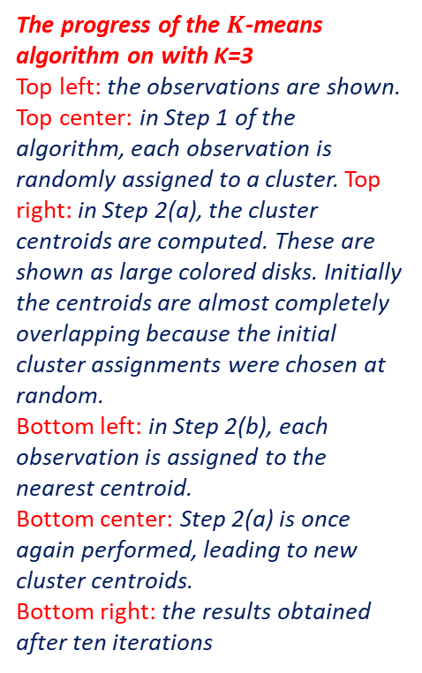
$K$-means Clustering Algorithm
The progress of the $K$-means algorithm on with K=3
Top left: the observations are shown.
Top center: in Step 1 of the algorithm, each observation is randomly assigned to a cluster. Top right: in Step 2(a), the cluster centroids are computed. These are shown as large colored disks. Initially the centroids are almost completely overlapping because the initial cluster assignments were chosen at random.
Bottom left: in Step 2(b), each observation is assigned to the nearest centroid.
Bottom center: Step 2(a) is once again performed, leading to new cluster centroids.
Bottom right: the results obtained after ten iterations

Slide 15
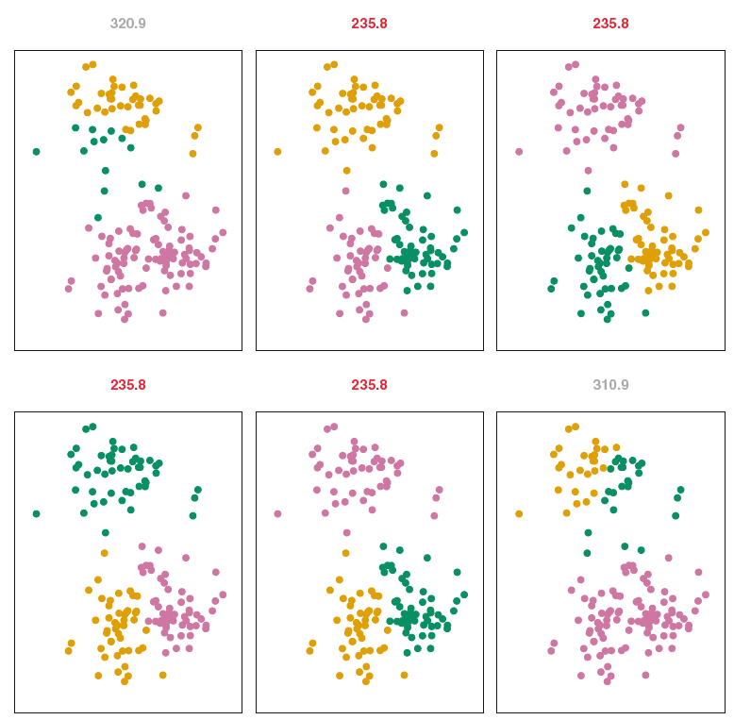
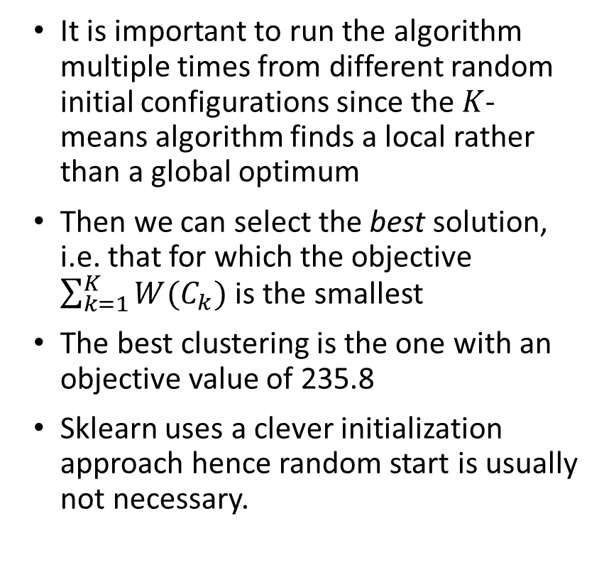
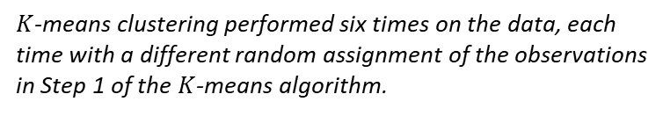
$K$-means Clustering Algorithm
It is important to run the algorithm multiple times from different random initial configurations since the $K$-means algorithm finds a local rather than a global optimum
Then we can select the best solution, i.e. that for which the objective $\sum_{k=1}^{K}{W(C_{k})}$ is the smallest
The best clustering is the one with an objective value of 235.8
Sklearn uses a clever initialization approach hence random start is usually not necessary.
$K$-means clustering performed six times on the data, each time with a different random assignment of the observations in Step 1 of the $K$-means algorithm.

Slide 16
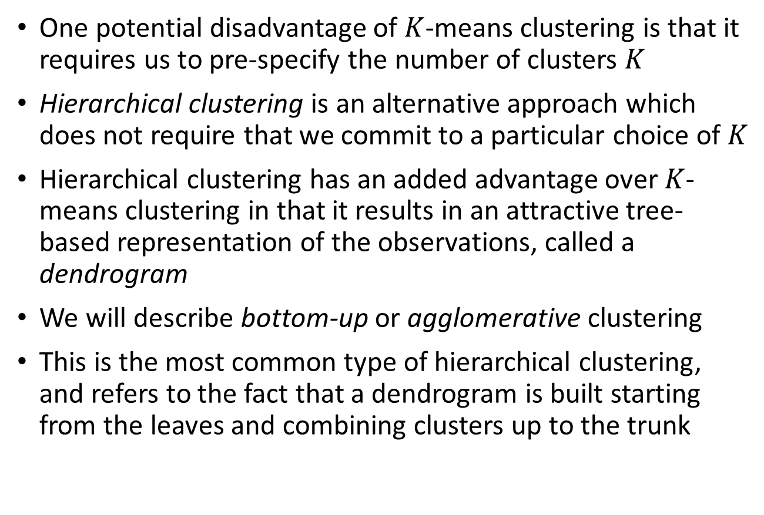
Hierarchical Clustering
One potential disadvantage of $K$-means clustering is that it requires us to pre-specify the number of clusters $K$
Hierarchical clustering is an alternative approach which does not require that we commit to a particular choice of $K$
Hierarchical clustering has an added advantage over $K$-means clustering in that it results in an attractive tree-based representation of the observations, called a dendrogram
We will describe bottom-up or agglomerative clustering
This is the most common type of hierarchical clustering, and refers to the fact that a dendrogram is built starting from the leaves and combining clusters up to the trunk

Slide 17
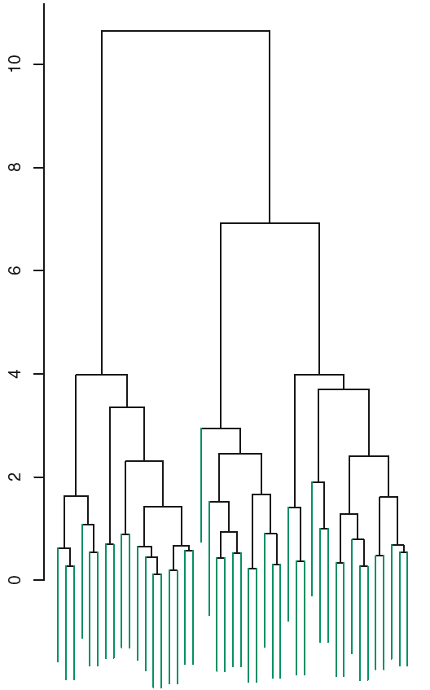
Interpreting Dendogram
Hierarchical clustering (with complete linkage, to be discussed later) yields the result shown in the figure
We begin with a discussion on interpretation of a dendrogram and then discuss how hierarchical clustering is actually performed
Each leaf of the dendrogram represents one of the 45 observations
As we move up the tree, some leaves begin to fuse into branches
These correspond to observations that are similar to each other

Slide 18
Interpreting Dendogram
The height of a fusion, as measured on the vertical axis, indicates how different the two observations are
Thus, observations that fuse at the very bottom of the tree are quite similar to each other,
Whereas observations that fuse close to the top of the tree will tend to be quite different

Slide 19
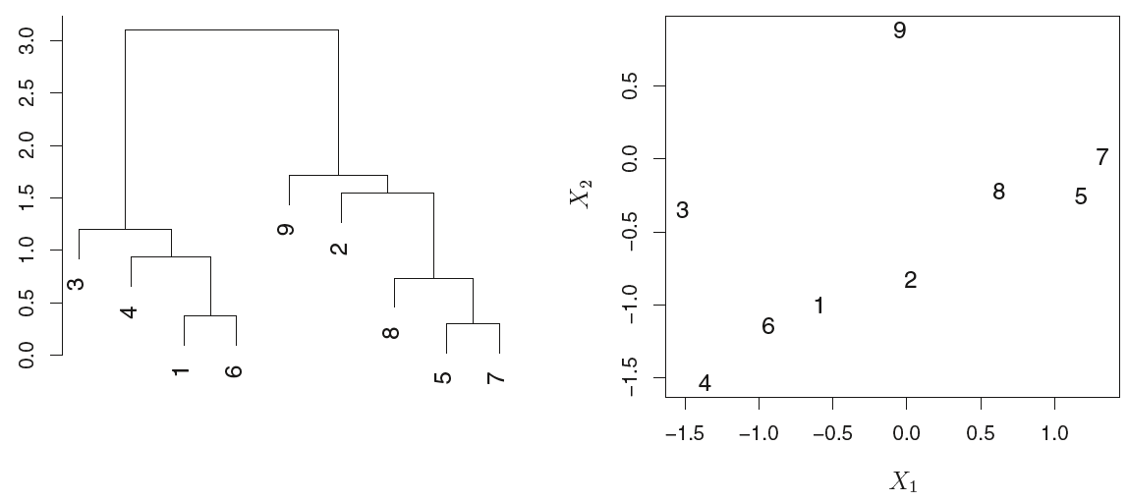
Interpreting Dendogram
A very important point in interpreting dendrograms that is often misunderstood is as follows
Consider a simple dendrogram obtained from hierarchically clustering nine observations
Observations 5 and 7 are quite similar to each other, as are observations 1 and 6. However, observation 9 is no more similar to observation 2 than it is to observations 8, 5, and 7, even though observations 9 and 2 are close together in terms of horizontal distance

Slide 20
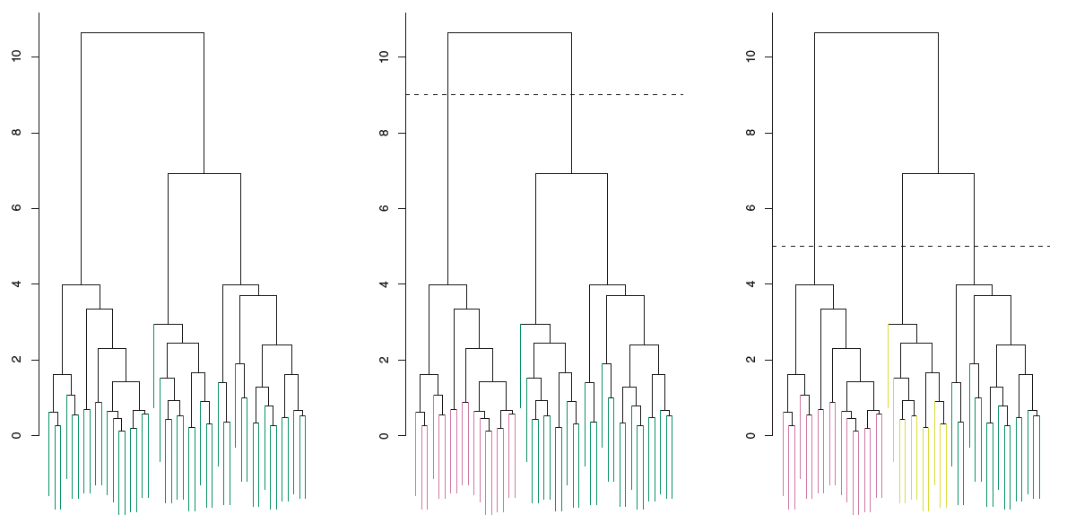
Identifying Clusters via Dendogram
Now that we understand how to interpret, we can move on to the issue of identifying clusters on the basis of a dendrogram
In order to do this, we make a horizontal cut across the dendrogram, as shown in the center and right-hand panels
One single dendrogram can be used to obtain any number of clusters by making different cuts
However, often the choice of where to cut the dendrogram is not so clear
Center: the dendrogram from the left-hand panel, cut at a height of nine (indicated by the dashed line). This cut results in two distinct clusters, shown in different colors.
Right: the dendrogram from the left-hand panel, now cut at a height of five. This cut results in three distinct clusters, shown in different colors

Slide 21
Hierarchical Clustering Algorithm
The hierarchical clustering dendrogram is obtained via an extremely simple algorithm
We begin by defining some sort of dissimilarity measure between each pair of observations
Most often, Euclidean distance is used
The algorithm proceeds iteratively
Starting out at the bottom of the dendrogram, each of the n observations is treated as its own cluster
The two clusters that are most similar to each other are then fused so that there now are n−1 clusters
Next the two clusters that are most similar to each other are fused again, so that there now are n − 2 clusters
The algorithm proceeds in this fashion until all of the observations belong to one single cluster, and the dendrogram is complete

Slide 22
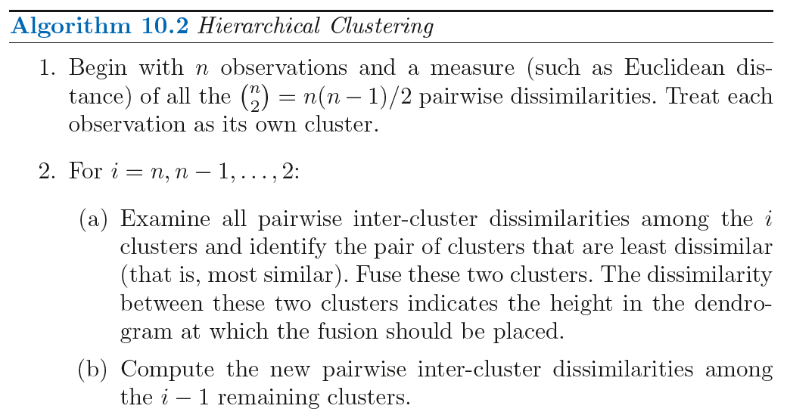
Hierarchical Clustering Algorithm

Slide 23
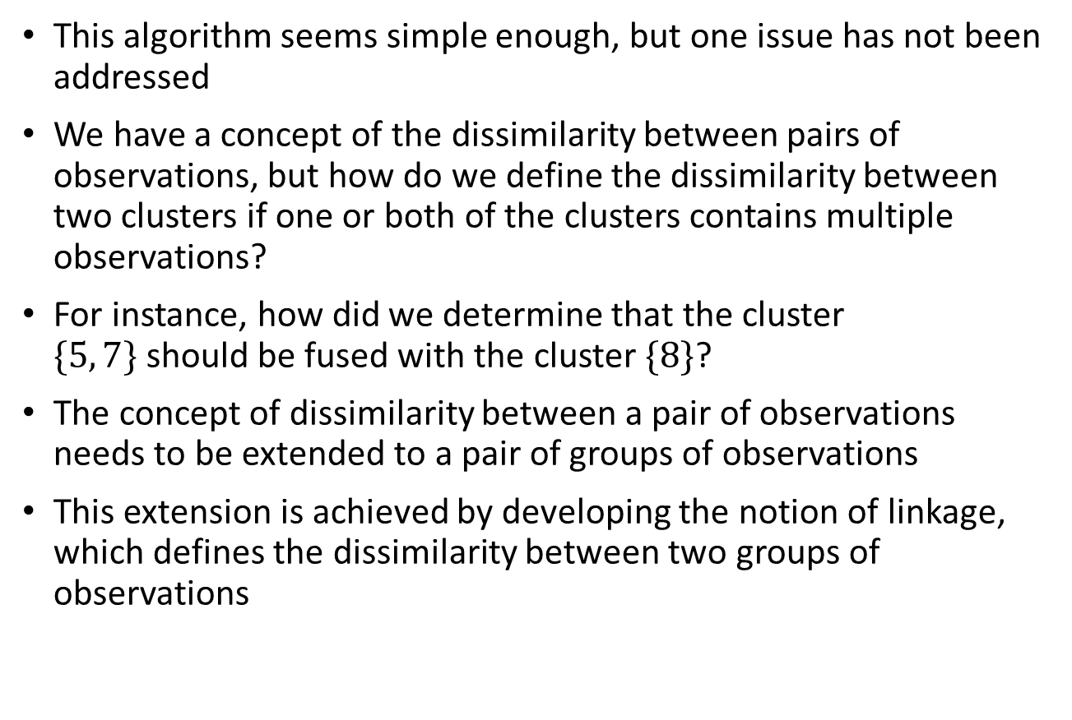
Hierarchical Clustering Algorithm
This algorithm seems simple enough, but one issue has not been addressed
We have a concept of the dissimilarity between pairs of observations, but how do we define the dissimilarity between two clusters if one or both of the clusters contains multiple observations?
For instance, how did we determine that the cluster $\{5, 7\}$should be fused with the cluster $\{8\}$?
The concept of dissimilarity between a pair of observations needs to be extended to a pair of groups of observations
This extension is achieved by developing the notion of linkage, which defines the dissimilarity between two groups of observations

Slide 24
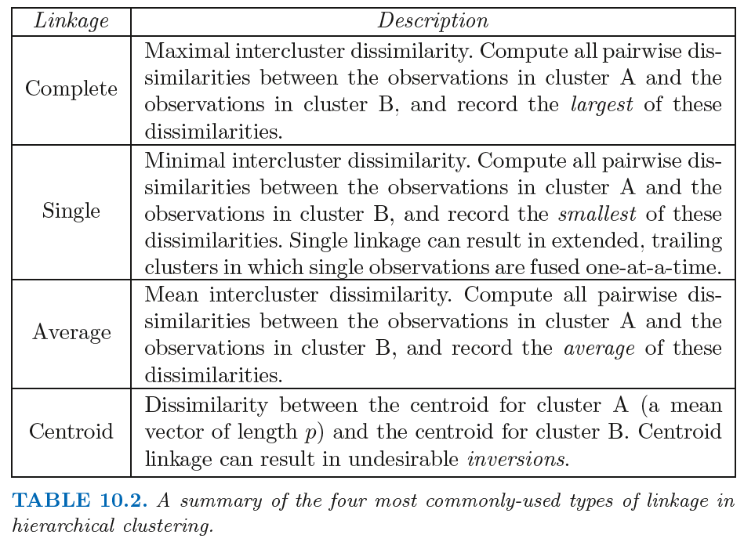
Hierarchical Clustering Algorithm
The four most common types of linkage—complete, average, single, and centroid—are briefly described in the Table
Average, complete, and single linkage are most popular among statisticians. Average and complete linkage are generally preferred over single linkage, as they tend to yield more balanced dendrograms. Centroid linkage is often used in genomics, but suffers from a major drawback in that an inversion can occur, whereby two clusters are fused at a height below either of the individual clusters in the dendrogram. This can lead to difficulties in visualization as well as in interpretation of the dendrogram

Slide 25
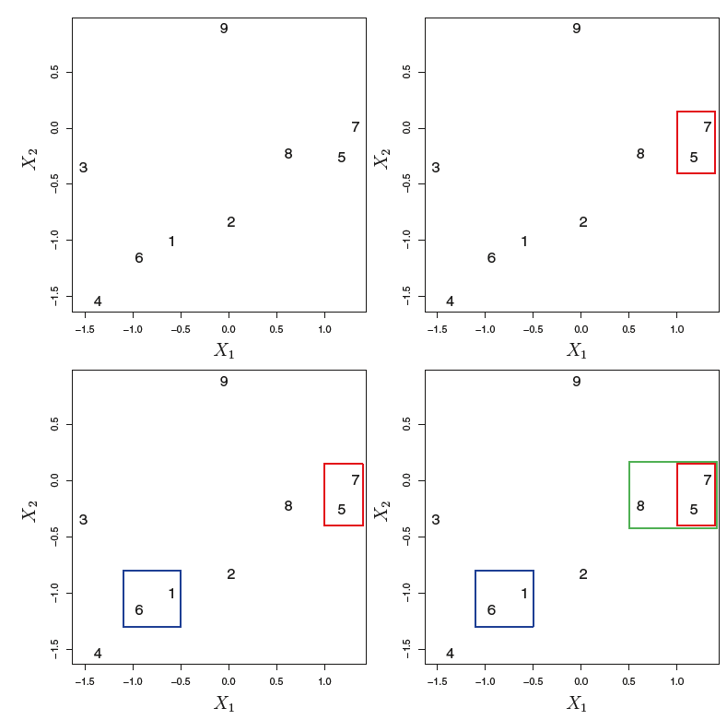
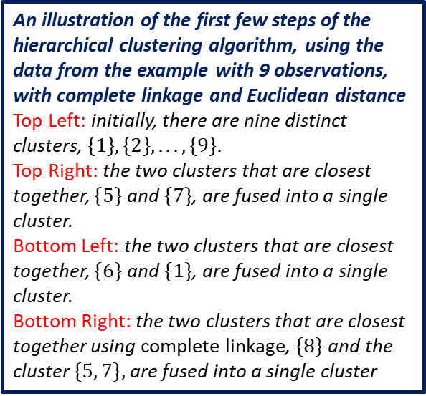
Hierarchical Clustering Algorithm
An illustration of the first few steps of the hierarchical clustering algorithm, using the data from the example with 9 observations, with complete linkage and Euclidean distance
Top Left: initially, there are nine distinct clusters, $\{1\}, \{2\}, . . . , \{9\}.$
Top Right: the two clusters that are closest together, $\{5\}$ and $\{7\}$, are fused into a single cluster.
Bottom Left: the two clusters that are closest together, $\{6\}$ and $\{1\}$, are fused into a single cluster.
Bottom Right: the two clusters that are closest together using complete linkage, $\{8\}$and the cluster $\{5, 7\},$are fused into a single cluster

Slide 26
Practical Issues in Clustering – Some Decisions to be Made
In order to perform clustering, some decisions must be made
Should the observations or features first be standardized in some way? For instance, maybe the variables should be centered to have mean zero and scaled to have standard deviation one
In the case of hierarchical clustering,
What dissimilarity measure should be used?
What type of linkage should be used?
Where should we cut the dendrogram in order to obtain clusters?
In the case of K-means clustering, how many clusters should we look for in the data?
Each of these decisions can have a strong impact on the results obtained
In practice, we try several different choices, and look for the one with the most useful or interpretable solution

Slide 27
Practical Issues in Clustering - Validation
We want to know whether the clusters that have been found represent true subgroups in the data, or whether they are simply a result of clustering the noise
For instance, if we were to obtain an independent set of observations, then would those observations also display the same set of clusters?
This is a hard question to answer
There exist a number of techniques for assigning a p-value to a cluster in order to assess whether there is more evidence for the cluster than one would expect due to chance
However, there has been no consensus on a single best approach

Slide 28
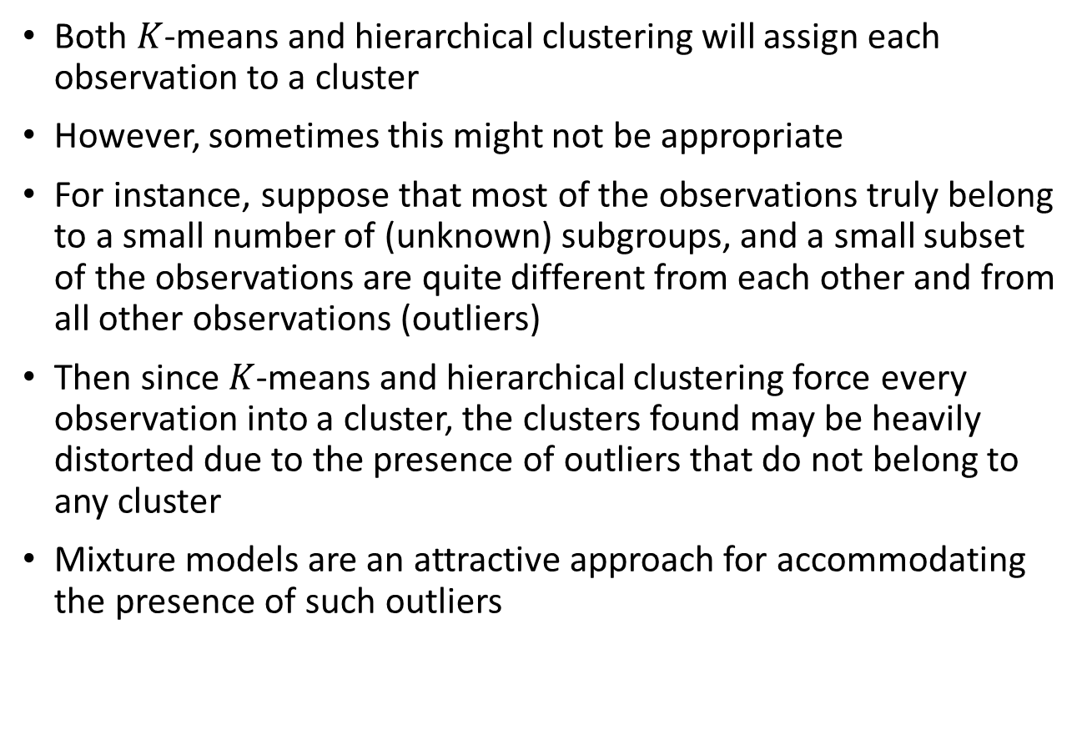
Practical Issues in Clustering - Outliers
Both $K$-means and hierarchical clustering will assign each observation to a cluster
However, sometimes this might not be appropriate
For instance, suppose that most of the observations truly belong to a small number of (unknown) subgroups, and a small subset of the observations are quite different from each other and from all other observations (outliers)
Then since $K$-means and hierarchical clustering force every observation into a cluster, the clusters found may be heavily distorted due to the presence of outliers that do not belong to any cluster
Mixture models are an attractive approach for accommodating the presence of such outliers

Slide 29
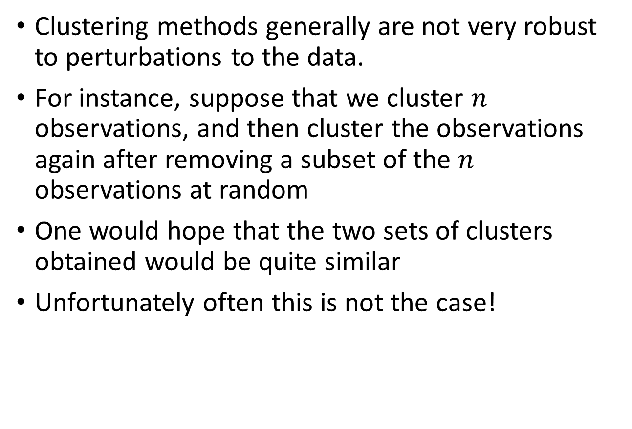
Practical Issues in Clustering - Robustness
Clustering methods generally are not very robust to perturbations to the data.
For instance, suppose that we cluster $n$ observations, and then cluster the observations again after removing a subset of the $n$ observations at random
One would hope that the two sets of clusters obtained would be quite similar
Unfortunately often this is not the case!

Slide 30
Clustering Recommendations
Clustering can be a very useful and valid tool if used properly
Small decisions, such as how the data are standardized and what type of linkage is used, can have a large effect on the results
Therefore, it is recommended that performing clustering with different choices of these parameters, and looking at the full set of results in order to see what patterns consistently emerge
Since clustering can be non-robust, it is recommended that clustering subsets of the data in order to get a sense of the robustness of the clusters obtained
Clustering results should not be taken as the absolute truth about a data set
Rather, they should constitute a starting point for the development of a scientific hypothesis and further study, preferably on an independent data set

